Slide 1

Sentiment Analysis: How is Your Brand Viewed on Twitter?
MATT B JACKSON | DSC 680 (SUMMER 2020) | BELLEVUE UNIVERSITY

Slide 2
INTRODUCTION
With society relying more and more on Social Media, how a business is portrayed online is crucial for success. Harnessing the power of Social Media can help a business identify potential problems, wins for the company, and areas of improvement.

Slide 3
PROBLEM STATEMENT
The brand that will be examined here is Disney, specifically their eCommerce division shopDisney.com
shopDisney has had some trials and tribulations with it’s major product releases. This project was going to originally look at the tweets during the week of a major product release to see how impactful it was to negative tweeting. However, a last minute cancellation of this release changed the course of the project. Now it will look at the tweets during the same time period, focusing on the date the cancellation was announced, June 18th.

Slide 4
WHAT’S THE GOAL?
There are three major goals of this project:
Create a Machine Learning Model that analyzes tweets and determines if it is a positive or negative tweet.
Using the Twitter API, download tweets and save them in a CSV file for later processing.
Create a web based Dashboard to display the results to the user.

Slide 5
WHAT DATA WILL BE USED?
In order to create the Machine Learning Model, pre-classified tweets need to be used. The dataset being used for this project is called Sentiment140. It contains over 1 million tweets classified as either: positive, neutral, or negative. Since this project is only looking at positive and negative, the neutral ones will be filtered out.

Slide 6
METHODS – MACHINE LEARNING MODEL
The Machine Learning Model will be constructed using Python, specifically the scikit-learn package.
Since the tweets are going to be classified as either positive or negative, a Binary Classifier will be used, specifically Logistic Regression.

Slide 7
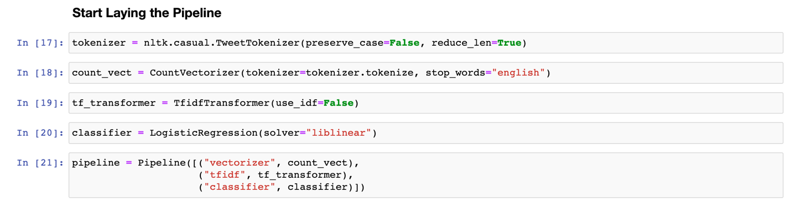
METHODS – MACHINE LEARNING MODEL

Slide 8
METHODS – USING TWITTER API
This was the easiest task of the project. Using the Tweepy library a weeks worth of Tweets was extracted, processed to only keep date and text, then saved for later consumption by the Dashboard.

Slide 9
METHODS – CREATING WEB DASHBOARD
In order to create a web based Dashboard, Flask (a Python based web server) will be used. The benefit of using this is that since it is Python, it is able to run the scripts that gather and save the tweets without any issues,
In terms of GUI, standard HTML, CSS and jQuery will be used via the Bootstrap framework coupled with the Chart.js library.

Slide 10
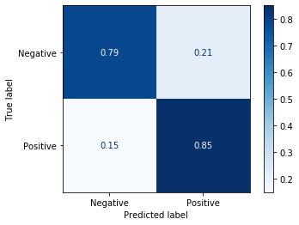
RESULTS – MACHINE LEARNING MODEL
After processing the data from Sentiment140, a model was created that resulted in an accuracy around 81%
Using this model with a small amount of tweets from June 7th through June 12th resulted in the following confusion matrix

Slide 11
RESULTS – USING TWITTER API
With the model created, it’s time to collect new tweets to analyze. Looking at the specified time range, 1432 tweets were downloaded. This excludes any retweets and any replies from shopDisney. Retweets are just duplicate tweets and most replies from shopDisney are cookie cutter responses. Using them would skew results.

Slide 12
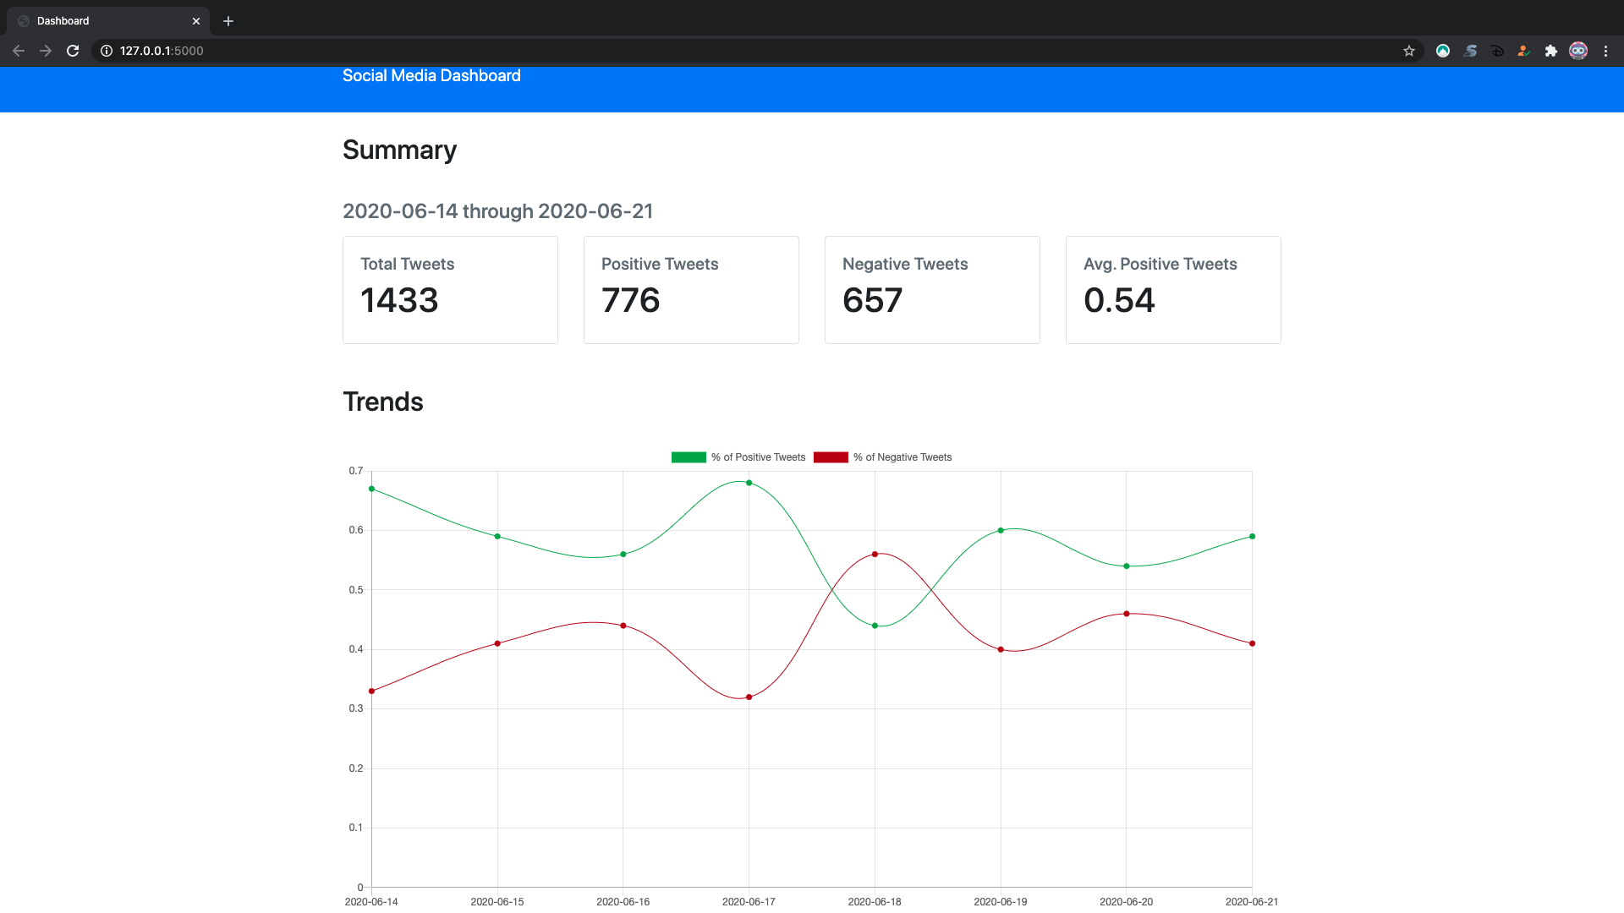
RESULTS – CREATING WEB DASHBOARD

Slide 13
CONCLUSION
The goal of this project was to see if it was feasible to create a solution to track how a brand is viewed on Social Media. What was discovered is that it is very possible, and easy, to create a dashboard to see how feeling change over time. Using a tool like this can help guide and educate brands on what they are doing right or wrong.

